Slide 1

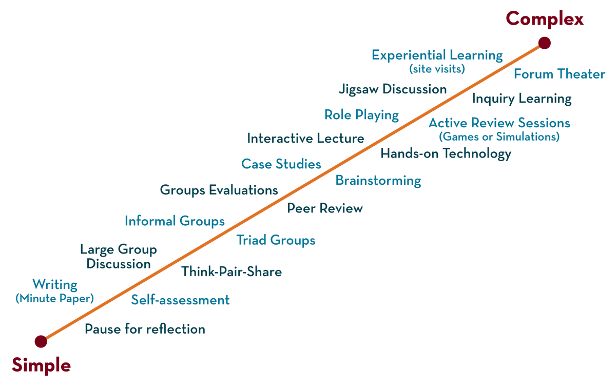
Department of CSE
Deep Learning
20CS3269AA
Topic:
LOSS FUNCTIONS
Session - 5

Slide 2



AIM OF THE SESSION
To familiarize students with the concept of Loss functions
INSTRUCTIONAL OBJECTIVES
This Session is designed to:
Demonstrate the Loss functions
Know about Surrogate Loss Functions
Discuss Challenges in Neural Network Optimization
LEARNING OUTCOMES
At the end of this session, you should be able to:
Able to understand loss functions and challenges in optimization

Slide 3
SESSION INTRODUCTION
The topics covered in the session are
Surrogate Loss Functions
Early Stopping

Slide 4
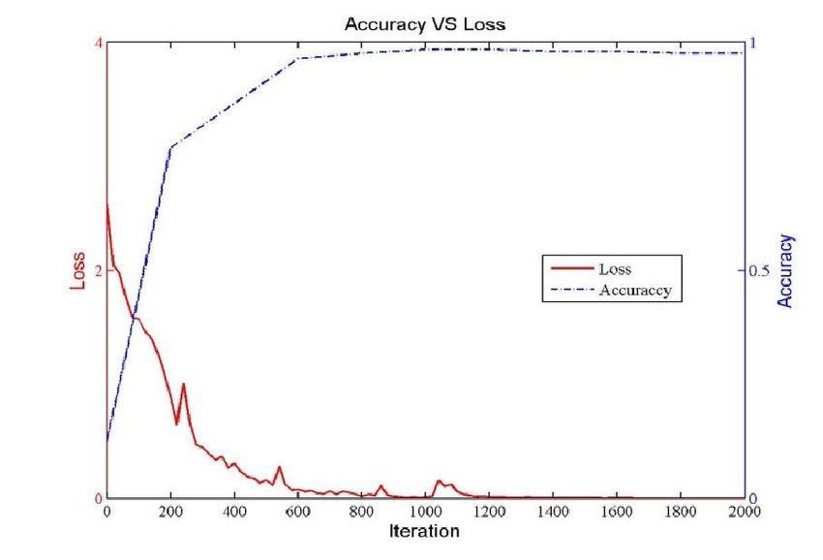
Loss function
A loss function is a method of evaluating how well your algorithm models your dataset.
If your predictions are totally wrong then loss function will be higher number. If predictions accuracy is high then loss will be minimum.

Slide 5

Loss function
Loss function, L(·), to compute the difference between the desired output, and our approximation to it, given the current value of the parameters, e. The approximation error, or loss, is the sum of losses over the individual instances
Y-predicted | f(x )=y | (Y-f(x))²
102 | 100 | 4
135 | 130 | 25
141 | 140 | 1
118 | 120 | 4
147 | 150 | 9

Slide 6
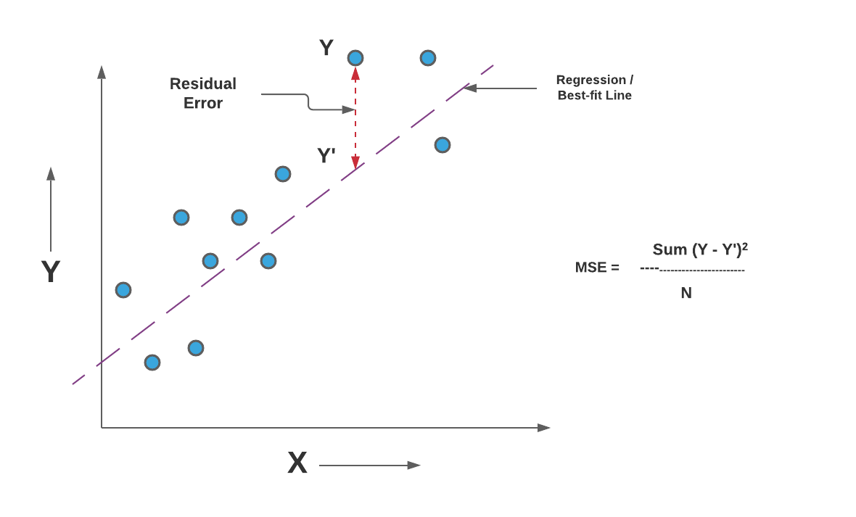
Error in linear regression

Slide 7
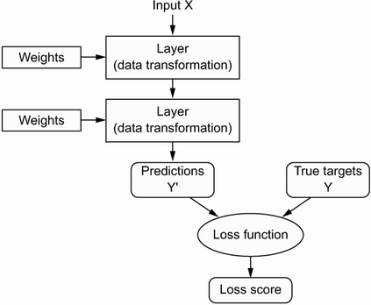
Loss function
Deep learning use the loss score as a feedback signal to adjust the value of the weights , in a direction that will lower the loss score for the current example
This adjustment of weight is done by the optimizer, and is implemented in the Backpropagation algorithm

Slide 8
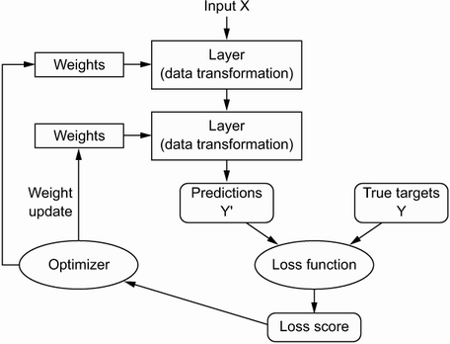
The role of optimizer
Optimizers are algorithms or methods used to change the attributes of the neural network such as weights and learning rate to reduce the losses.
Optimizers are used to solve optimization problems by minimizing the function

Slide 9
ML VS DL w.r.t. loss
In Machine Learning (ML), we care about a certain performance measure P (for e.g. accuracy) defined w.r.t the test set and optimize J(θ) (for e.g. cross-entropy loss) with the hope that it improves P as well.
In pure optimization, optimizing J(θ) is the final goal.
The expected generalization error (risk) is taken over the true data-generating distribution . it becomes an optimization problem.
that a core challenge of machine learning is the need to generalize from a limited set of examples to a broader, unknown pattern.
Notes:
In optimization, we care only about the data in hand. We know that finding the maximum value will be the best solution to our problem. In Deep Learning, we mostly care about generalization i.e the data we don’t have.

Slide 10
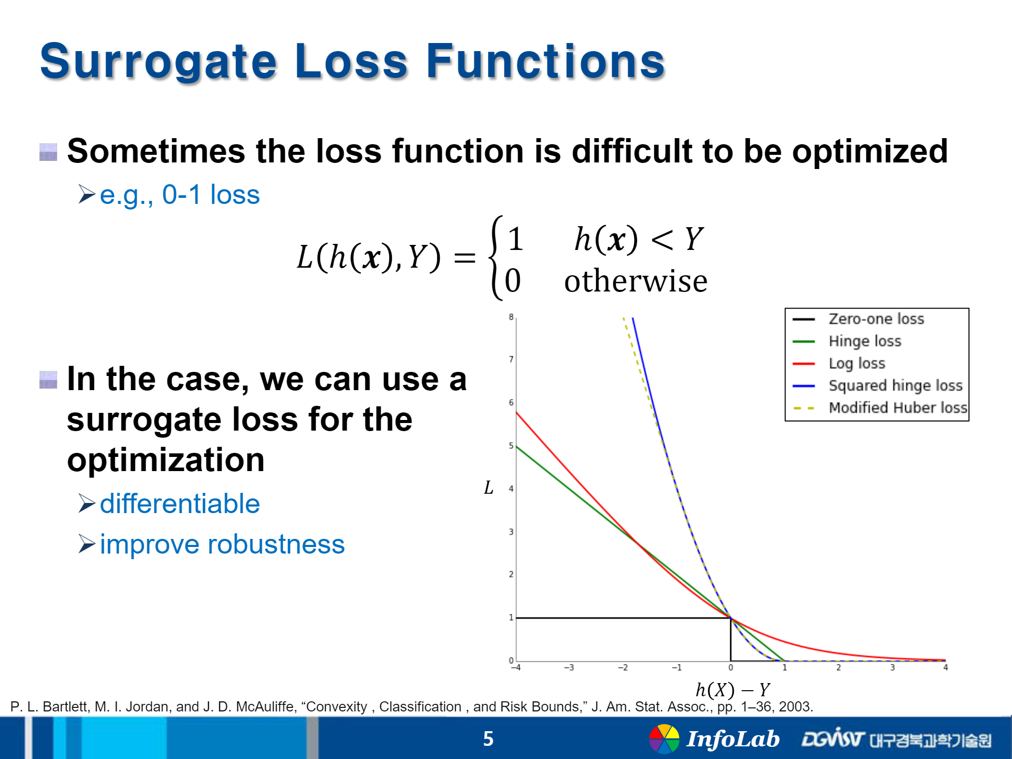
Surrogate function

Slide 11
Surrogate loss function
if a loss function cannot be optimized efficiently.
For example, the 0-1 loss function is discontinuous.
So, we consider another loss function which we call the surrogate loss function.

Slide 12
Early stopping.
Machine learning algorithm usually minimizes a surrogate loss function.
It halts when a convergence criterion based on early stopping is satisﬁed.
Early stopping criterion is based on the true underlying loss function, such as 0-1 loss measured on a validation set, and is designed to cause the algorithm to halt whenever overﬁtting begins to occur.
Training often halts while the surrogate loss function still has large derivatives,
An optimization algorithm is considered to have converged when the gradient becomes very small

Slide 13
Summary
Optimizer is method /techniques which minimize the loss function.
Surrogate loss function is a function which can’t be optimised easily
Early stopping is one type of regularization technique which is used to overcome overfit problem

Slide 14
SELF-ASSESSMENT QUESTIONS
1. Surrogate loss is ________________
3
2. What is the purpose of a loss function?
Calculate the error value of the forward network
Optimize the error values according to the error rate
Both A and B
None
3._______ regularization technique involves each neuron having a probability p of being temporarily "dropped"
A) Dropout
B) PCA
C) Manifold learning
D) Projection

Slide 15
TERMINAL QUESTIONS
Find the saddle points for the function f(x,y)=x²-y²
What surrogate loss?
Illustrate first order cost function

Slide 16
REFERENCES FOR FURTHER LEARNING OF THE SESSION
Books:
1 Ian Goodfellow and Yoshua Bengio and Aaron Courville (2016) Deep Learning Book
Sites and Web links:
https://shanzhenren.github.io/csci-699-replnlp-2019fall/lectures/W4-L1-Training_DNNs_I.pdf
https://medium.com/inveterate-learner/deep-learning-book-chapter-8-optimization-for-training-deep-models-part-ii-438fb4f6d135
.

Slide 17
Department of CSE
Deep Learning
20CS3269AA
Topic:
Challenges in Neural Network Optimization
&
Gradien descent
Session - 6

Slide 18
AIM OF THE SESSION
To familiarize students with the challenges in optimization and the concept of Gradient Descent (GD)
INSTRUCTIONAL OBJECTIVES
This Session is designed to:
Challenges in in neural network optimization
Demonstrate the Gradient Descent (GD)
LEARNING OUTCOMES
At the end of this session, you should be able to:
Able to apply Gradient Descent (GD) for optimization

Slide 19
SESSION INTRODUCTION
The topics covered in the session are
Challenges in Neural Network Optimization
What is Gradient Descent (GD)
Gradient Descent (GD) algorithm
Problem on GD

Slide 20
SESSION DESCRIPTION

Slide 21
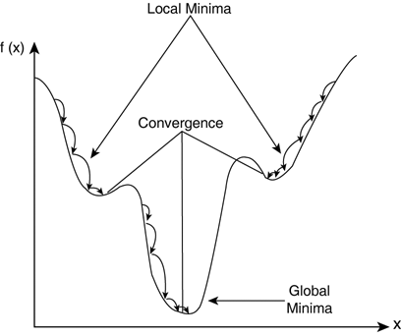
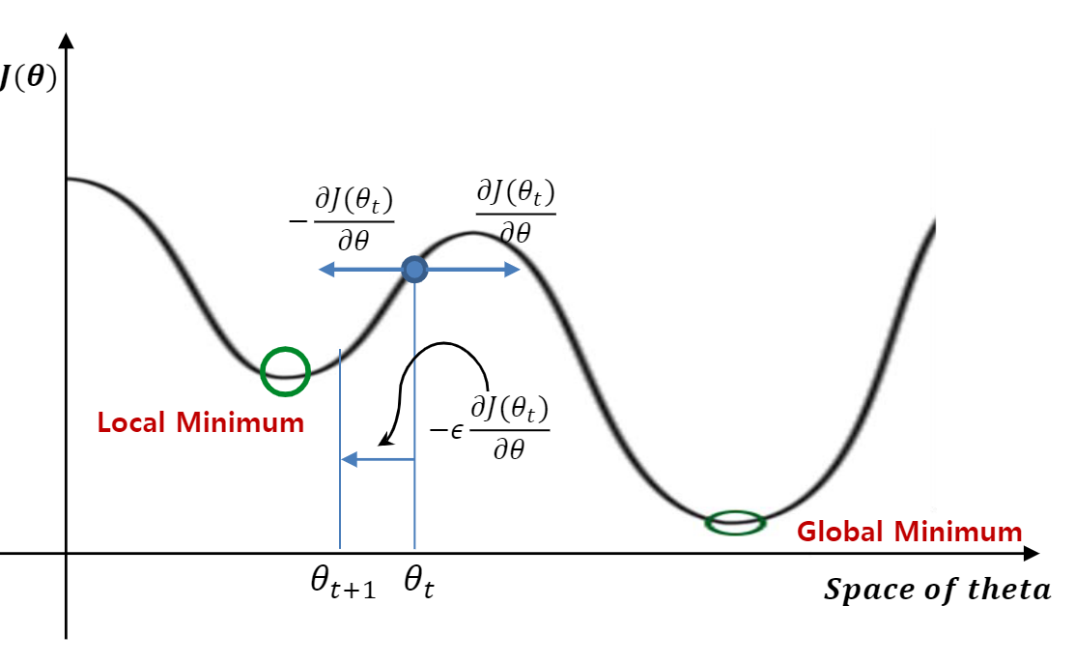
Challenges in Neural Network Optimization
1. Local minima: Generally any DL model is guaranteed to have an extremely large number of local minima (LM) arising due to the model identifiability problem
Notes:
For any objective function f(x), if the value of f(x) at x is smaller than the values of f(x) at any other points in the vicinity of x, then f(x) could be a local minimum. If the value of f(x) at x is the minimum of the objective function over the entire domain, then f(x) is the global minimum.

Slide 22
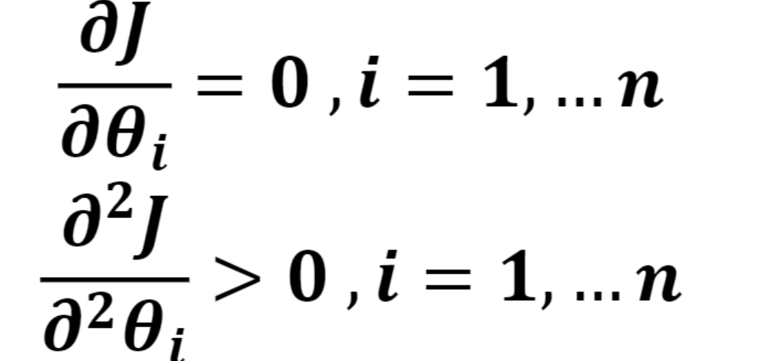
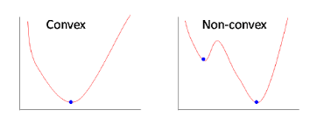
Local minima ….
For any objective function f(x), if the value of f(x) at x is smaller than the values of f(x) at any other points in the vicinity of x, then f(x) could be a local minimum
For many high dimensional con-convex functions local minima’s are very rare cases. Because local minima should satisfy .

Slide 23
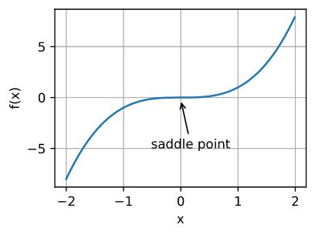
Challenges in Neural Network Optimization …
2. Plateaus, Saddle Points and Other Flat Regions:
Saddle point (SP) is another type of point with zero gradient where some points around it have higher value and the others have lower.
A saddle point is any location where all gradients of a function vanish but which is neither a global nor a local minimum.

Slide 24
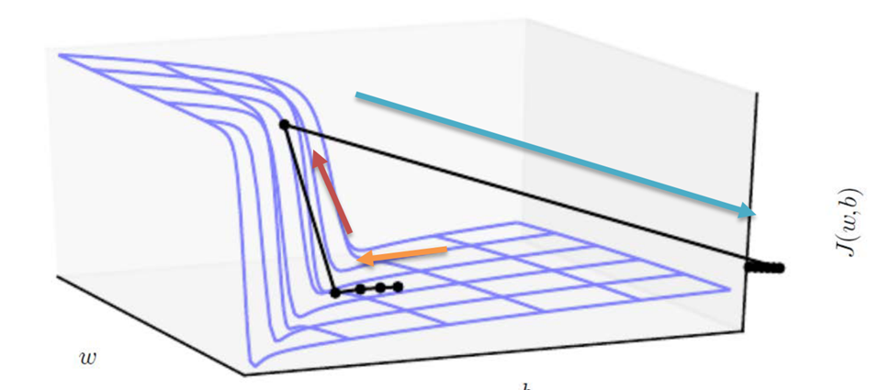
Challenges in Neural Network Optimization……
3.Cliffs and Exploding Gradients:
NNs might sometimes have extremely steep regions resembling cliffs due to the repeated multiplication of weights.
At the edge of such a cliff, an update step might throw the parameters extremely far. It can be taken care of by using gradient clipping (GC).
The gradient indicates only the direction in which to make the update. If the GD update proposes making a very large step, GC intervenes to reduce the step size.
If gradient update step can move the parameter extremely far is an exploring gradient problem

Slide 25
Challenges in Neural Network Optimization …
4. ill-conditioning
The ill-conditioning problem is generally believed to be present in neural network training problems.
Ill-conditioning can manifest by causing SGD to get “stuck” in the sense that even very small steps increase the cost function.
Ill condition occurs when this condition is true
Where g is first order gradient and H is second order derivative or Hessian matrix

Slide 26
Identifiers for Ill-conditioning
Loss values do not seem to decrease. This could mean that the loss function performs larger updates which leads the gradient to bounce around in the function.
Sometimes NaN values can be observed in the loss values. One explanation for this is that the loss values could have exploded due to larger learning rates or larger weights. In addition to ill-conditioning, this can also be an indicator for exploding gradients problem.

Slide 27
Learning rate
What is learning rate?
Learning rate (alpha) is a hyper-parameter used to control the rate at which an algorithm updates the parameter estimates or learns the values of the parameters.
It is used to scale the magnitude of parameter updates during gradient descent.
Learning rate is a scalar, a value that tells the machine how fast or how slow to arrive at some conclusion.
Effect of small and large learning rates
If the learning rate (alpha) is too small, learning will take so long to converge
if the learning rate is too large, during learning, it may miss to converge.

Slide 28
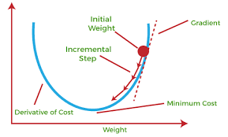
What is gradient decent
Gradient descent is an optimization algorithm
It is utilized to minimize the cost function used in various machine learning/Deep learning algorithms to update the parameters of the learning model.
In linear regression, these parameters are coefficients, and in the neural network, they are weights and bias.
Steps should be made in proportion to the negative of the function gradient (move away from
the gradient) at the current point to find local minima.
Gradient Ascent is the procedure for approaching
a local maximum of a function by taking steps proportional
to the positive of the gradient (moving towards
the gradient).

Slide 29
Gradient decent algorithm
repeat until convergence
{
w = w - (learning_rate * (dJ/dw))
b = b - (learning_rate * (dJ/db))
}
Notes:
If the partial derivative is negative then the partial derivative term of gradient descent become positive and it would increase the weights of the linear regression equation which can be seen in the first graph.While in the second case the slope is positive which makes partial derivative term negative of the gradient descent which definitely decreases the value of the weights of the equation.

Slide 30
Parameters -
To implement a gradient descent algorithm we require
a cost function that needs to be minimized,
the number of iterations,
a learning rate to determine
the step size at each iteration while moving towards the minimum
partial derivates for weight & bias to update the parameters at each iteration and a prediction function.

Slide 31
Comparison Perceptron and Gradient Descent Rule
Perceptron learning rule guaranteed to succeed if
Training examples are linearly separable
Sufficiently small learning rate η
Linear unit training rules uses gradient descent
Guaranteed to converge to hypothesis with minimum squared error
Given sufficiently small learning rate η
Even when training data contains noise
Even when training data not separable by H

Slide 32
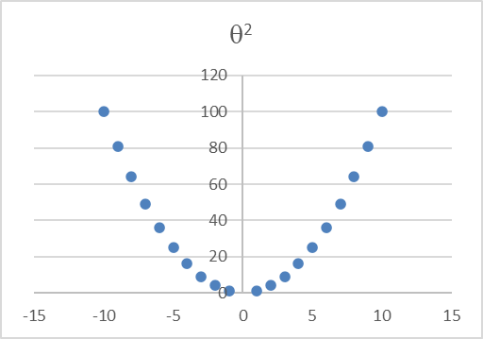
Example
Gradient function is θ²
Find the local minima of this function
Initializing θ as 2
Df/d θ= 2 θ, learning rate = 0.01
perform 4 iterations of gradient descent
Notes:
https://uclaacm.github.io/gradient-descent-visualiser/ x³ is for checking saddle point

Slide 33
Drawbacks of gradient decent
Gradient Descent uses the whole training data to update weight and bias.
Suppose if we have millions of records then training becomes slow and computationally very expensive.

Slide 34
Problem
Consider the following training set of m=4 training examples:
x y
1 0.5
2 1
4 2
0 0
Consider the linear regression model hθ(x)=θ₀+θ₁x. What are the values of θ₀ and θ₁ that you would expect to obtain upon running gradient descent on this model?
Notes:
solution θ₀=0,θ₁=0.5
As J(θ₀,θ₁)=0, y = h_{θ}(x) = θ₀ + θ₁x. Using any two values in the table, solve for θ₀, θ₁.

Slide 35
Type of sampling based algorithms
There are 3 types of sampling based algorithms
- batch gradient descent (BGD) -where the entire training set is used to make a single update,
stochastic gradient descent (SGD) where a single example is used to make an update
and mini-batch gradient descent (MBGD) where a batch (not to be confused with BGD) of examples is randomly sampled from the entire training set and is used to make an update.

Slide 36
Batch Gradient Descent
Batch gradient descent (BGD) is used to find the error for each point in the training set and update the model after evaluating all training examples. This procedure is known as the training epoch. In simple words, it is a greedy approach where we have to sum over all examples for each update.
Advantages of Batch gradient descent:
It produces less noise in comparison to other gradient descent.
It produces stable gradient descent convergence.
It is Computationally efficient as all resources are used for all training samples.

Slide 37
Summary
Optimization process has challenges like
Local minima
Plateaus, Saddle Points and Other Flat Regions
Cliffs and
Exploding Gradients
ill-conditioning
Gradient decent is one of the optimization algorithm

Slide 38
SELF-ASSESSMENT QUESTIONS
True or False : Gradient Descent is an optimisation problem
Which of the following is not the a variant of Gradient Descent
Vanilla
ADAGRAD
ADAM
None of the above
3. Learning rate is a hyper parameter in Gradient Descent used to update the parameters in the optimisation problem True /False

Slide 39
TERMINAL QUESTIONS
Define Gradient Descent?
Solve the second order Gradient decent for the function 4x²+2x+2
If the learning rate is too small, then gradient descent may take a very long time to converge. Justify
4. How do you overcome the optimization challenges in neural network

Slide 40
REFERENCES FOR FURTHER LEARNING OF THE SESSION
Books:
1 Ian Goodfellow and Yoshua Bengio and Aaron Courville (2016) Deep Learning Book
Sites and Web links:
https://shanzhenren.github.io/csci-699-replnlp-2019fall/lectures/W4-L1-Training_DNNs_I.pdf
https://medium.com/inveterate-learner/deep-learning-book-chapter-8-optimization-for-training-deep-models-part-ii-438fb4f6d135

Slide 41
Department of CSE
Deep Learning
20CS3269AA
Topic:
Momentum based
Gradien descent
Session - 7

Slide 42
AIM OF THE SESSION
To familiarize students with the concept of Gradient Descent (GD)
INSTRUCTIONAL OBJECTIVES
This Session is designed to:
Demonstrate the momentum based Gradient Descent (MGD)
LEARNING OUTCOMES
At the end of this session, you should be able to:
Able to apply momentum based Gradient Descent (MGD) for optimization

Slide 43
Index
SESSION Introduction
The topics covered in the session are
Why we need
Momentum based Gradient Descent
Algorithm
Simple problem with momentum based GD

Slide 44
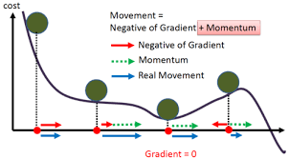
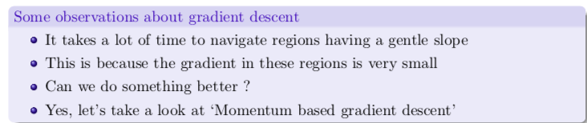
Drawbacks of GD –why we need momentum GD
Suppose if we have millions of records then training becomes slow and computationally very expensive in GD.
The gradient of the cost function at saddle points( plateau) is negligible or zero, which in turn leads to small or no weight updates
Hence, the network becomes stagnant, and learning stops

Slide 45
Gradient Descent with Momentum
Momentum is an extension to the gradient descent optimization algorithm, often referred to as gradient descent with momentum.
It takes small steps in directions where the gradients oscillate and take large steps along the direction where the past gradients have the same direction(same sign).
It is designed to accelerate the optimization process, e.g. decrease the number of function evaluations required to reach the optima,
to improve the capability of the optimization algorithm, e.g. result in a better final result

Slide 46
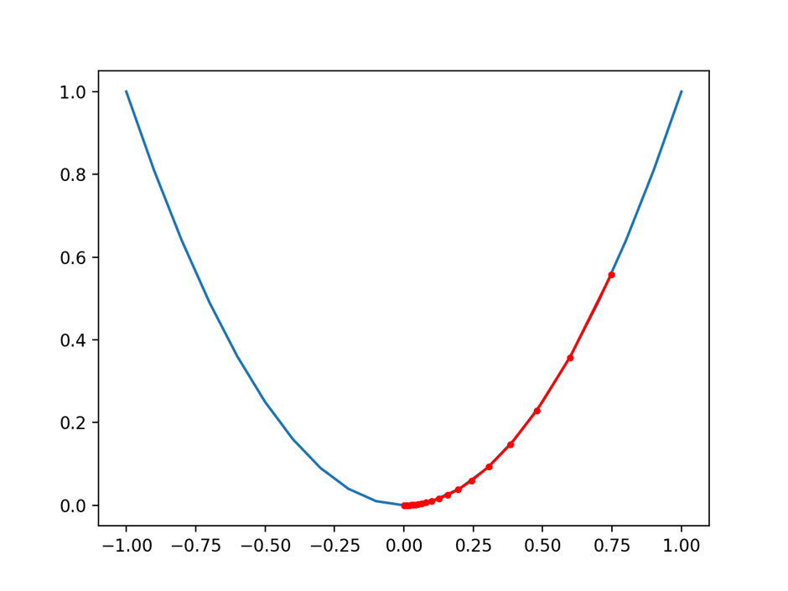
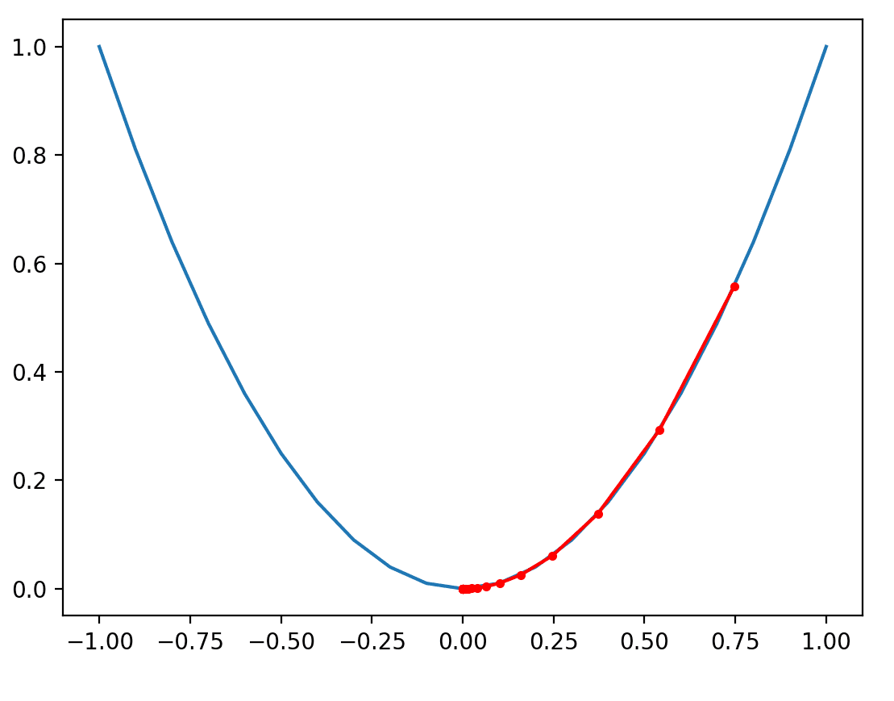
Gradient Decent
Momentum GD
the search reaches the optima in more steps
the search reaches the optima in fewer steps, noted with fewer distinct red dots on the path to the bottom of the basin.

Slide 47
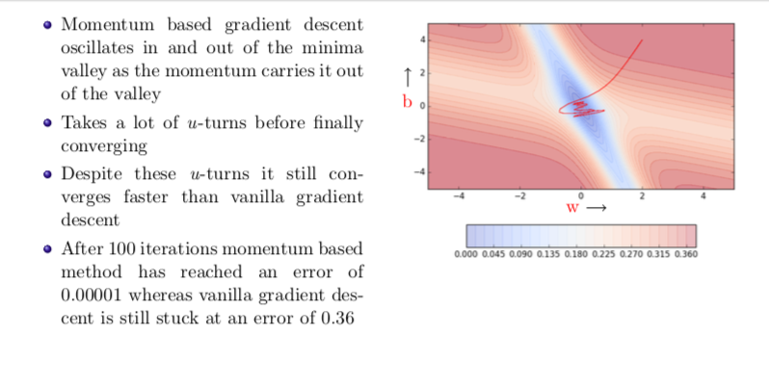
Momentum based Gradient Descent (Cont..)

Slide 48
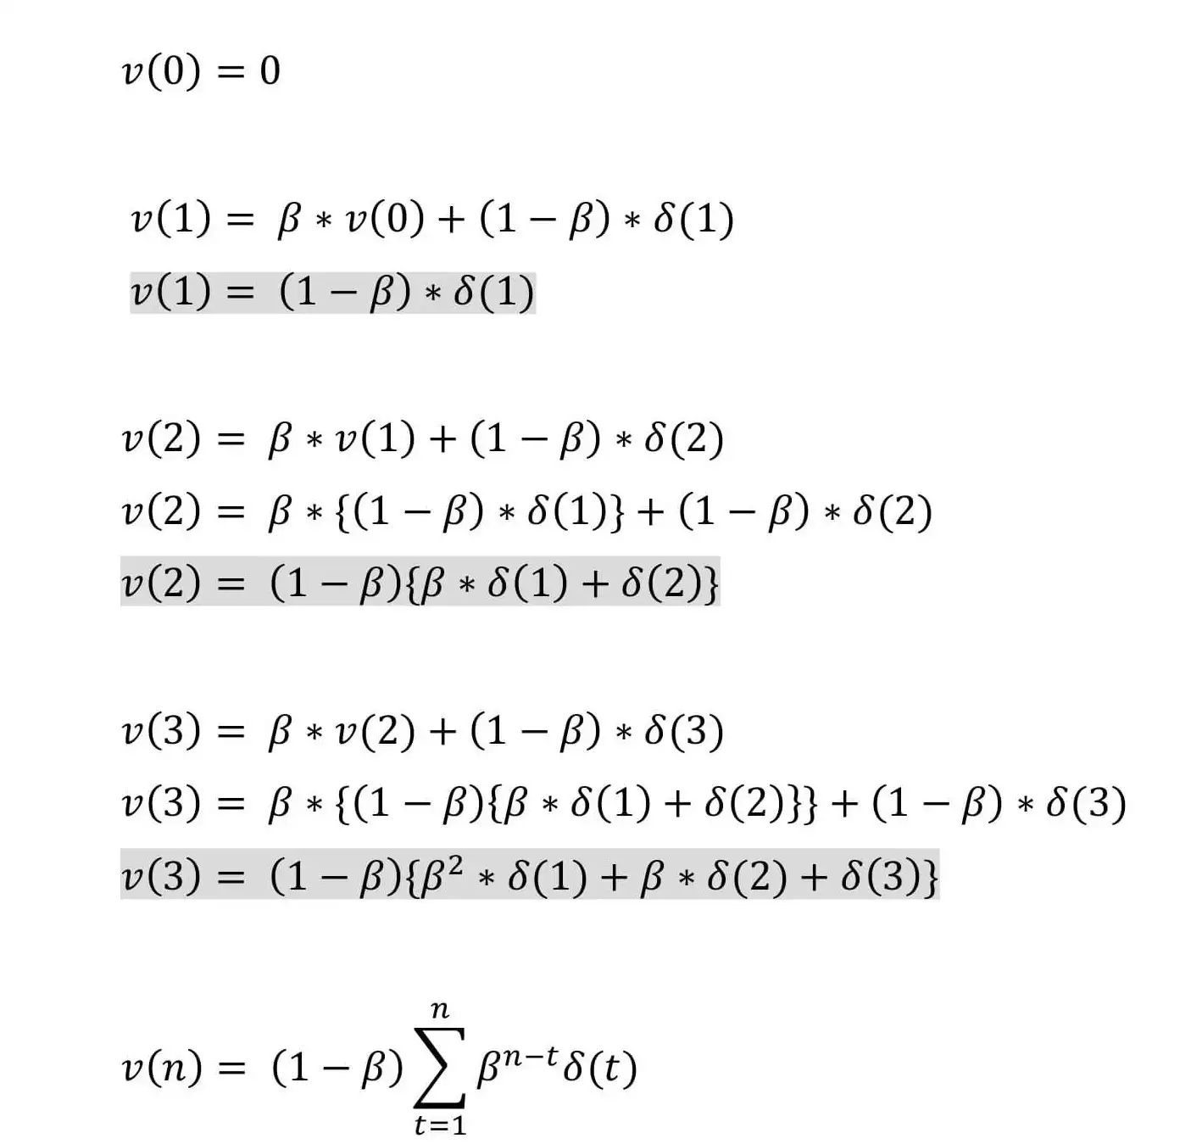
Momentum based Gradient Descent (Cont..)
Update rule:
Where
𝓥(t): is the new weight update done at iteration t
β: Momentum constant
𝛿(t): is the gradient at iteration t

Slide 49
SESSION DESCRIPTION
The momentum (beta) must be higher to smooth out the update because we give more weight to the past gradients.
Using the default value for β = 0.9 is suggested but can be tuned between 0.8 to 0.999 if needed.
Momentum takes into account past gradients so as to smooth down gradient measures.
It can be implemented with descent by batch gradient, descent by mini-batch gradient or descent by stochastic gradient.

Slide 50
MBGD with minibatch
Generally batch sizes as powers of 2 to offer better runtime with certain hardware.
Small batches tend to have a regularizing effect because of the noise they inject as each update is made by seeing only a very small portion of the entire training set, a.k.a., a batch of samples.
The minibatches should be selected randomly. It is sufficient to shuffle the dataset once and iterate over it multiple times.
In the first epoch, the network sees each example for the first time and hence, the estimate of gradient is an unbiased estimate of the gradient of the true generalization error.
From the second epoch onwards, the estimate becomes biased as it is resampling from data that it has already seen

Slide 51
Summary
Gradient descent is an optimization algorithm that uses the gradient of the objective function to navigate the search space.
Gradient descent can be accelerated by using momentum from past updates to the search position.

Slide 52
SELF-ASSESSMENT QUESTIONS
1.Gradient Descent is an optimization algorithm used for,
A) Certain Changes in algorithm
B) minimizing the cost function in various machine learning algorithms
C) maximizing the cost function in various machine learning algorithms
D) remaining same the cost function in various machine learning algorithms
Ans: B
2._____is a type of gradient descent which processes 1 training example per iteration.
A) Batch Gradient Descent
B) Stochastic Gradient Descent
C) Mini Batch gradient descent
D) none of these
Ans: B

Slide 53
TERMINAL QUESTIONS
How does momentum work in gradient descent?
Can gradient descent with momentum overcome local minima?
Does momentum prevent Overfitting or underfitting?
X³+2x²-4x

Slide 54
REFERENCES FOR FURTHER LEARNING OF THE SESSION
Books:
1 Ian Goodfellow and Yoshua Bengio and Aaron Courville (2016) Deep Learning Book
Sites and Web links:
https://shanzhenren.github.io/csci-699-replnlp-2019fall/lectures/W4-L1-Training_DNNs_I.pdf
https://medium.com/inveterate-learner/deep-learning-book-chapter-8-optimization-for-training-deep-models-part-ii-438fb4f6d135
2.

